Slide 1
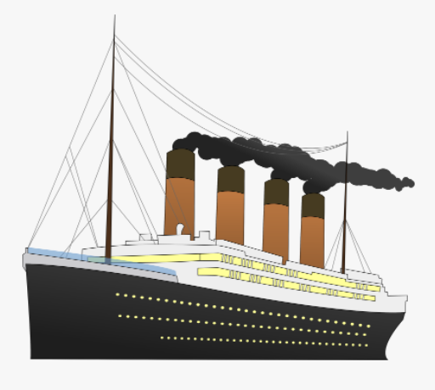
Titanic Survival Prediction
-Machine Learning Project
-Logistic Regression

Slide 2

Problem Statement
Survived
Or
Not Survived

Slide 3
